Slide 1
In Math We Trust Artificial Intelligence/ML
Instructor
Ren Shan
IEEE Senior Member
SAIC Fellow
June 30, 2020
Notes:
https://www.youtube.com/watch?v=GwIo3gDZCVQ

Slide 2
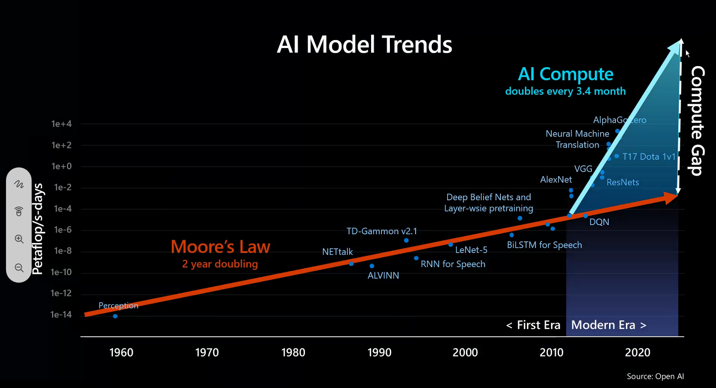
Notes:
A couple of things:
Is AI going to be smarter than human?
I used to have a dog, and it is very smart. But do we expect it can create things for us?
Is AI going to replace human?
AI will be a good helper, working with/for us, but it is not going to replace human.

Slide 3
Who is a ML Engineer/Scientist?
Top 10 Skills (6 hard skills and 4 soft skills)
Python
Linear Algebra
Advance Signal Processing
Applied Math & Algorithms
Neural Networks Architectures
NLP
-----------------------
Industry Knowledge
Effective Communication
Rapid Prototyping
Keep It Up/updated

Slide 4
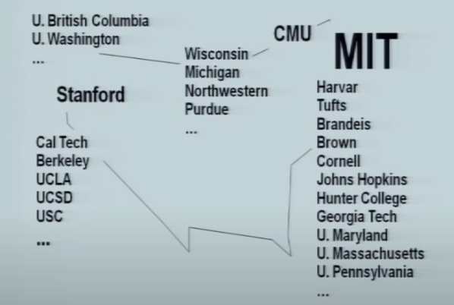
Where to go for a PHD/Graduate School Study in AI?

Slide 5
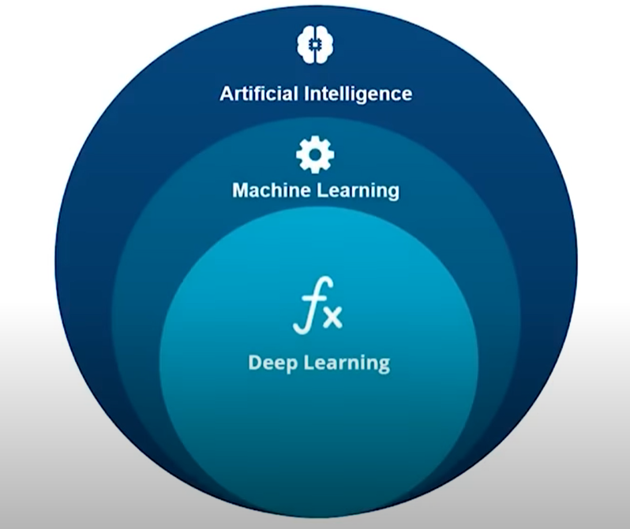
Class-1: AI vs ML vs Deep Learning
WHAT IS AI?
“Algorithms enabled by constraints & exposed by representations that support models targeted at thinking, perception and action.”
MIT Prof. Patrick Winston (1945-2019)
1950s-1970s - AI
Example of AI (Game Play)
1980s – 1990s - ML
Example of ML (“Expert” System)
2000s -2010s – DL - ANN
Artificial/Deep Neural Network
Example of Deep Learning
2020s … (challenges facing)
Notes:
70s: Game play (chess play)
80-90s: Guzman->Huffman->Waltz (decision tree, SVM)
2012: Alex Krizhevsky – University of Toronto
Challenges:
Speech to text, multiple languages.
Computer Vision, relationship (walk dogs)

Slide 6

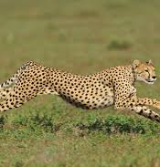
Class-1: Introduction to ML
Is this thing a cheetah?
Rule based “expert” system
Hair (R1) -> Mammal
Claws, Teeth, forward point eyes (R2) - Animal
Eat meat (R3) -> Carnivore
Run fast (R4)
Through Gate Tree -> Cheetah
Notes:
80s – Gate Tree and Rule based “expert” system (forward chain) - In fact, it is novices system.
How to tell this animal is a cheetah?

Slide 7
Constraints: Resource Allocations/Scheduling
F1: BOS -> JFK
F2: JFK->BOS
F3: BOS -> JFK
F4: JFK->BOS
F5: BOS -------------------------------→ LAX
Notes:
How many planes are needed? 4?
Is this a AI problem?
Constraints

Slide 8
Class-1: Introduction to ML – Knowledge Map
Search - British Museum Problem
Depth First (Binary Tree)
Breadth First (BT)
C
E
S
S
A
B
A
B
B
G
B
D
B
D
A
C
S
A
D
C
G
C
G
E
Notes:
This is an AI problem?
Direction is Left to Right

Slide 9
Class-1: Introduction to ML
Knowledge Engineering Rules:
Be Specific – domain
Know the subjects
Build the system with unit test - “Can the system answer questions of its own behaviors?”
Notes:
Using grocery bagging to explain the knowledge engineering 1. People don’t expect out with an engine oil?
2. How to arrange the things in the bag.
3. Be vigilant and bug if there is anything wrong, such as the piece of package is broken.

Slide 10
Class-1: Introduction to ML – what it takes?
Computer programming
Knowledge mining – search
Domain knowledge
Data Ingestion
Model Training
Humanity - AI Ethics (human behaviors and value lines)

Slide 11
Class-1: David Marr’s Theory – AI Approach
1. Define the problem
2. Devise Representation
3. Determine Approaches
4. Pick Mechanism
5. Experiment
EXPLICIT
EXPOSE CONSTRAINTS
LOCALNESS
Notes:
David Courtenay Marr (19 January 1945 – 17 November 1980) was a British neuroscientist and physiologist
You can not learn unless you know most of it.
We think with hands, mouths and eyes.
Great ideas are simple.

Slide 12
Class-1:Classification of Algorithm
Anomaly Detection Algorithm
Clustering Algorithm
Regression Algorithm
Demo: Iris Dataset

Slide 13
Class-1: Introduction to ML
Supervised Learning
knowing X and Y, generate a model to classification
Unsupervised Learning
knowing X but Y, generate a model to cluster
Reinforcement Learning
knowing X but Y, create an environment and learning agent

Slide 14
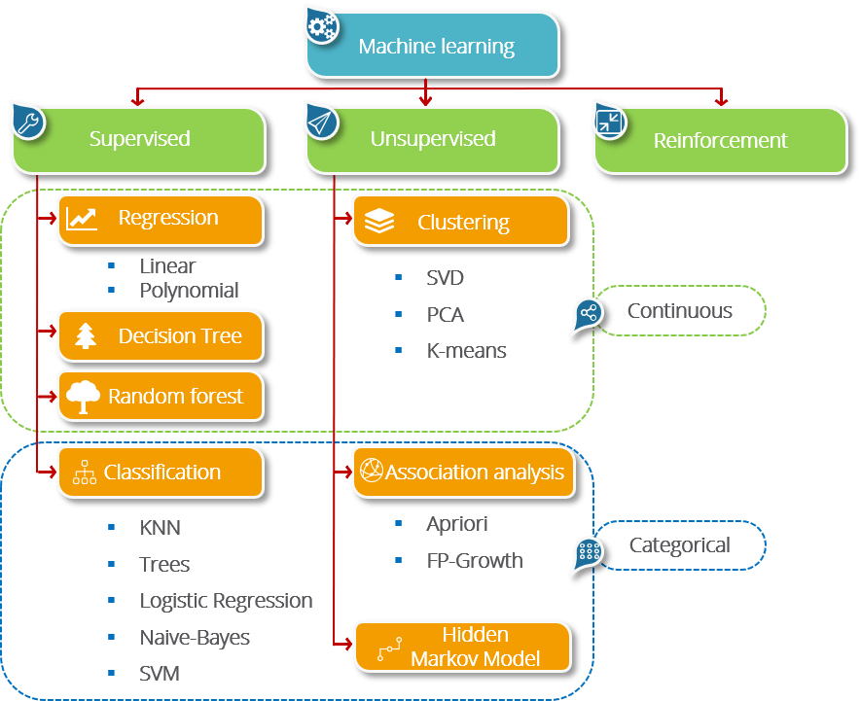
Class-1: Machine Learning Algorithms
Notes:
https://jakevdp.github.io/PythonDataScienceHandbook/05.09-principal-component-analysis.html
PCA above
Apriori below
https://www.kaggle.com/yugagrawal95/market-basket-analysis-apriori-in-python

Slide 15
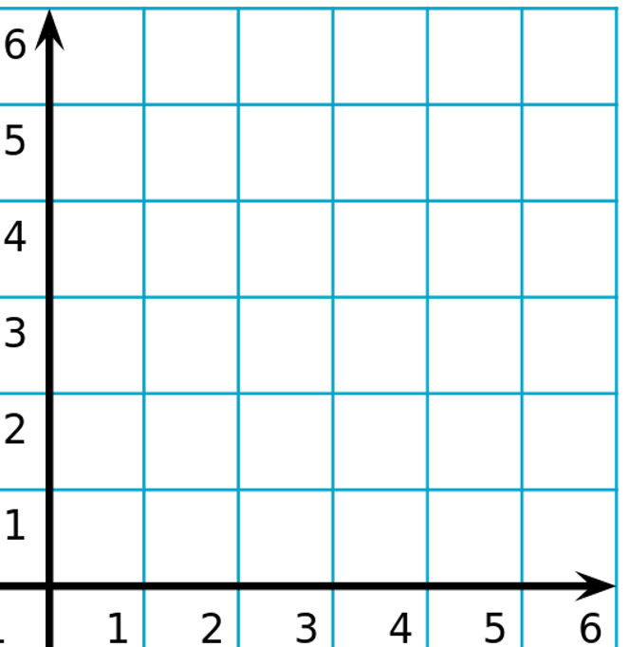
Class-1: AI are Experiments
KNN
Decision Tree

Slide 16
Class-1: Why AI is difficult
KNN
Decision Tree

Slide 17
Class-1: Why AI is difficult
KNN
Decision Tree
Notes:
So which one is better?
LOL …
Using Naïve Bayes to tell:
To extend a little bit, Diagnose (disease) – symptoms then classify , Lie detection, Fake news, Root Cause Analysis.
22. Probabilistic Inference II

Slide 18
Class-1:Classification of Algorithm
Anomaly Detection Algorithm
-- Identify unusual data points
Is there any fraud in this transactions
Is someone trying to hack our network
Clustering Algorithm
-- Group data based on some condition
Which type of house lies in this segment?
What type of customer buys this product?
Regression Algorithm
-- Data itself is predicted
what is the market value of this house?
Is it going to rain tomorrow?

Slide 19
Class-1: Demo Iris
Demo Iris

Slide 20
Class-2: Statistics & Probability for ML - Intro
What is Data
“Data refers to facts and statistics collected together for reference or analysis”
Categories of Data
Qualitative Data
Nominal Data (Scalar) vs. Ordinal Data (Vector)
Quantitative Data
Discrete Data vs. Continuous Data
What is Statistics
Basic Terminologies in Statistics
Measure of Central tendency
Measure of Variability (spread)
Maximum, Average, Minimum, …

Slide 21
Class-2: Statistics & Probability for ML
Basic Terminologies in Statistics
Population vs Sample
Sampling Techniques
Random Sampling
Systematic Sampling
Stratified Sampling

Slide 22
Class-2: Types of Statistics
Descriptive Statistics
Maximum Average Minimum
Inferential Statistics
Large Medium Small

Slide 23
Class-2: Descriptive Statistics
Measure of Center
Mean,
Median,
Mode (most popular one)
Measures of Spread (Variability)
Range = Max(xi) – Min(xi)
Inter Quartile Range,
Variance,
Standard Deviation
Information Gain & Entropy
Confusion Matrix

Slide 24
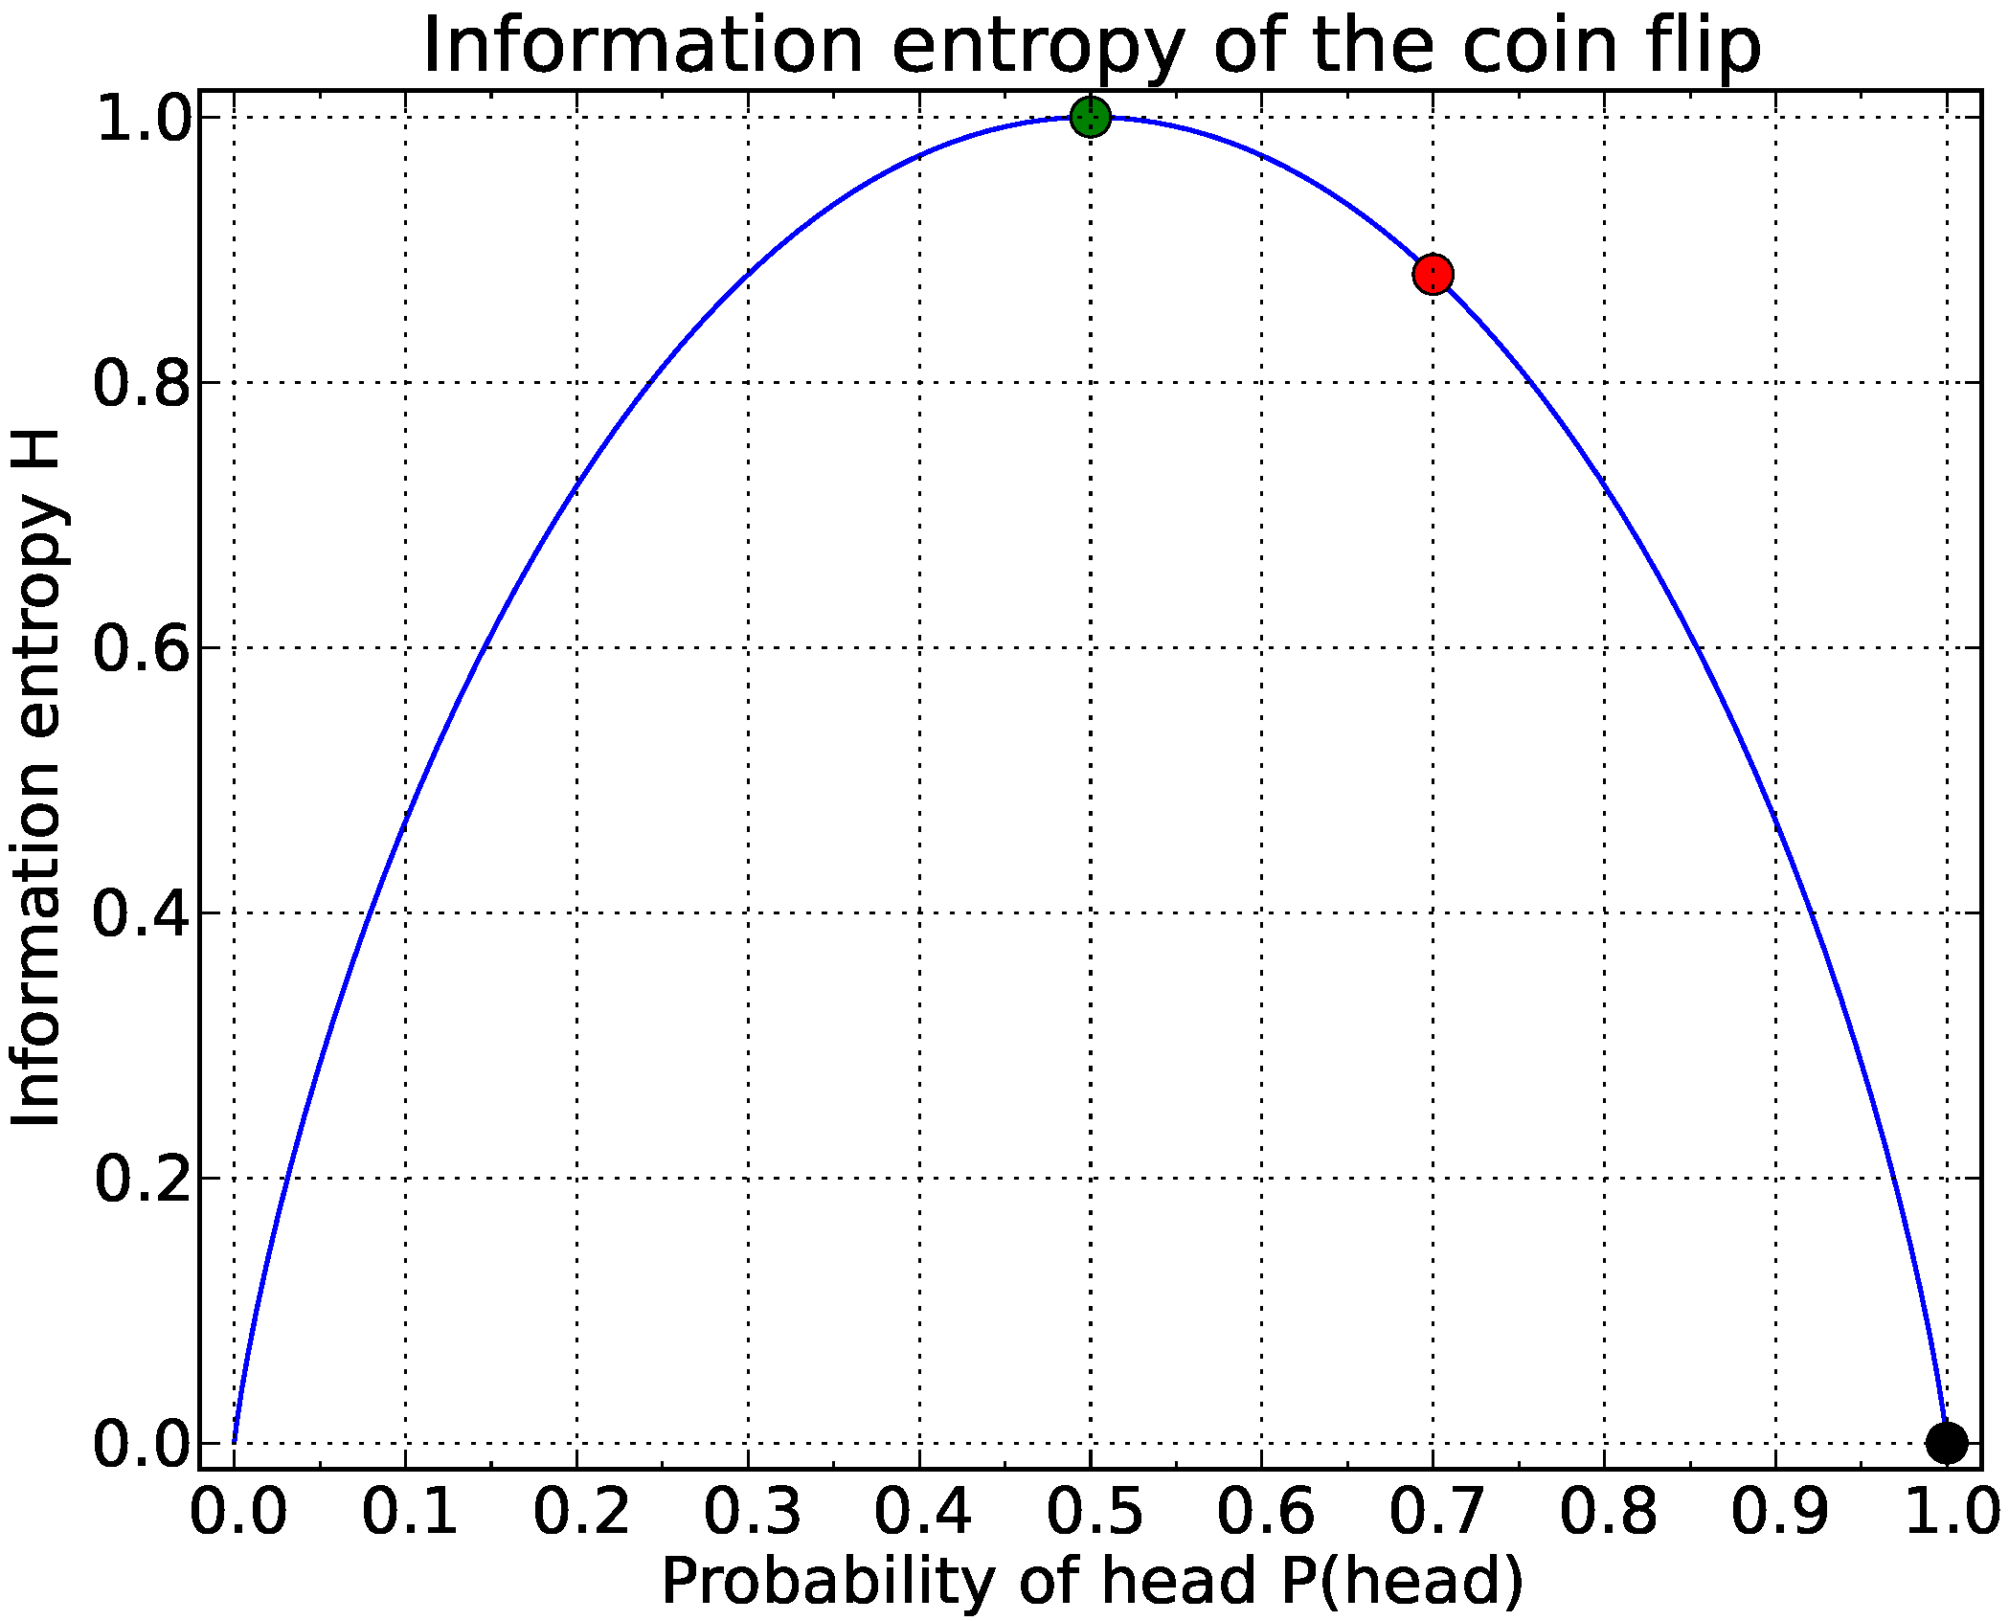
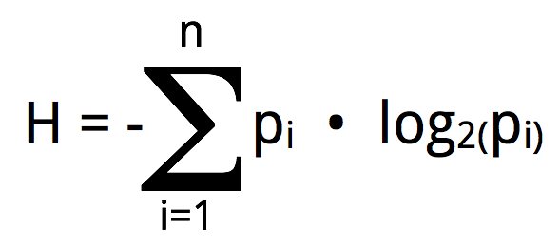
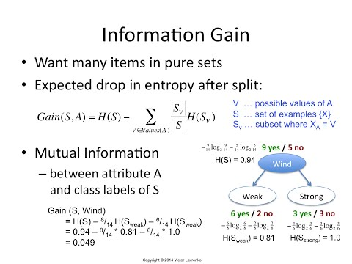
Class-2: Information Gain & Entropy
Entropy
Information Gain

Slide 25
Class-2: Confusion Matrix
In class research
Definitions:
Accuracy
Precision
Recall
False positive
False negative
F-measure(F-1)
Notes:
https://www.geeksforgeeks.org/confusion-matrix-machine-learning/

Slide 26
Class-2: Probability
Probability Terminologies
Types of Events
Probability of Distribution
Types of Probability
Marginal Probability
Joint Probability
Conditional Probability
Use-Case
Bayes Theorem

Slide 27

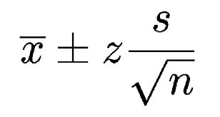
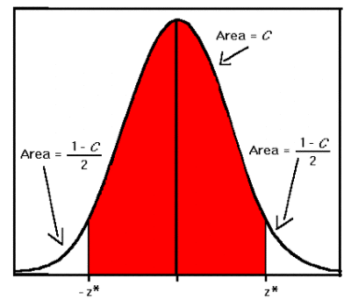
Class-2: Inferential Statistics
Point Estimation
Interval Estimate
Margin of Error
X – point estimation
S – standard deviation
N – sample number
z – the sample standard z-score
Area C is the level of confidence
The Z-score is the interval of estimate based on the Z value

Slide 28
Class-2: Hypothesis Testing
Statisticians use hypothesis testing to formally check whether the hypothesis is accepted or rejected
Hypothesis testing is conducted in the following manner:
State the Hypotheses – This stage involves stating the null and alternative hypotheses
Formulate an Analysis Plan – This stage involves the construction of an analysis plan
Analyze Sample Data – This stage involves the calculation and interpretation of the test statistic as described in the analysis plan
Interpret Results – This stage involves the application of the decision rule described in the analysis plan

Slide 29
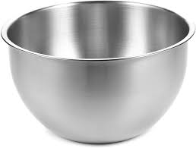
Class-2: Hypothesis Testing Example
4 members : Nick, John, Bob and Harry to draw for cleaning room
John was able to draw and not to clean the room for many times.
State the Hypotheses – what is the probability that John is not cheating
Formulate an Analysis Plan – This stage involves the construction of an analysis plan:
P(John not picked for a day) = ¾
P(John not picked for 3 days) = ¾ X ¾ X ¾ = .42 = 42%
P(John not picked for 12 days) = (3/4)**12 = 0.032
Analyze Sample Data – This stage involves the calculation and interpretation of the test statistic as described in the analysis plan
Probability of Event < .05 (5%)
Interpret Results – This stage involves the application of the decision rule described in the analysis plan

Slide 30
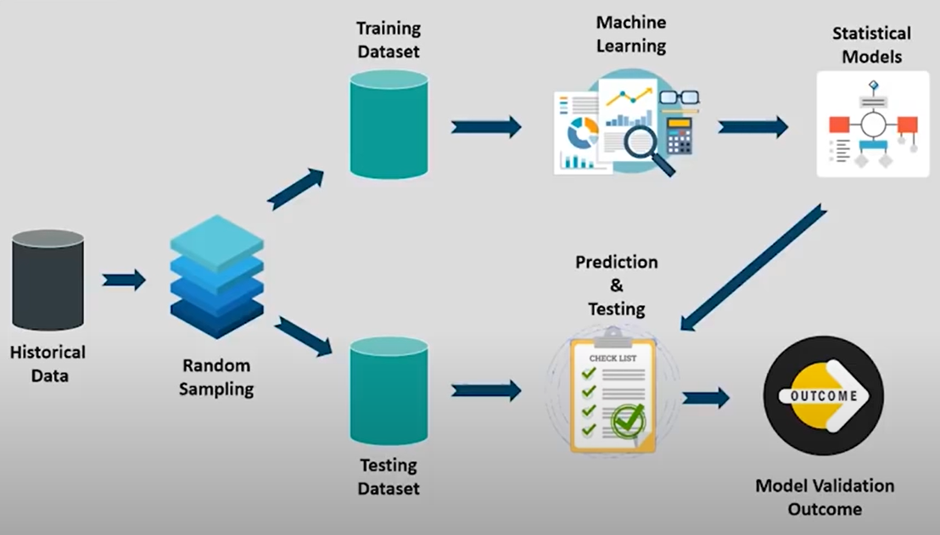
Class-2: Supervised Learning Algorithms
Training and Testing
Prediction

Slide 31
Class-2: Supervised Learning Algorithms
Regression
Linear vs Logistic Regression
Understanding Linear Regression Algorithm
Logistic Regression Curve
Titanic Data Analysis
Decision Tree
Random Forest
Naïve Bayers Classifier

Slide 32
Class-2: Supervised Learning Algorithms – Linear Regression
“Regression analysis is form of predictive modelling technique with investigates the relationship between a dependent and independent variable.”
Uses of Regression
Determining the strength of predictions
Relationship between the salary and education
Forecasting an effect
What will be salary for a new employee with certain skills
Trend forecasting
What will be the price of bitcoin in next 6 months

Slide 33
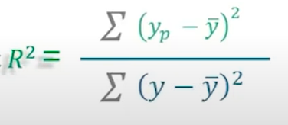
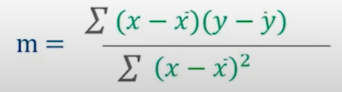
Class-2: Linear Regression
x | y | x - X | y - Y | (x – X) ** 2 | (x – X)(y – Y) | Yp
1 | 3 | -2 | -0.6 | 4 | 1.2 | 2.8
2 | 4 | -1 | 0.4 | 1 | -0.4 | 3.2
3 | 2 | 0 | -1.6 | 0 | 0 | 3.6
4 | 4 | 1 | 0.4 | 1 | 0.4 | 4
5 | 5 | 2 | 1.4 | 4 | 2.8 | 4.4
3 | 3.6 |  |  | 10 | 4
Programming…..
m = 4/10
y = 0.4 x + 2.4
R2 = 0.3
Notes:
https://www.kaggle.com/codefordata/headbrain-simple-linear-regression

Slide 34
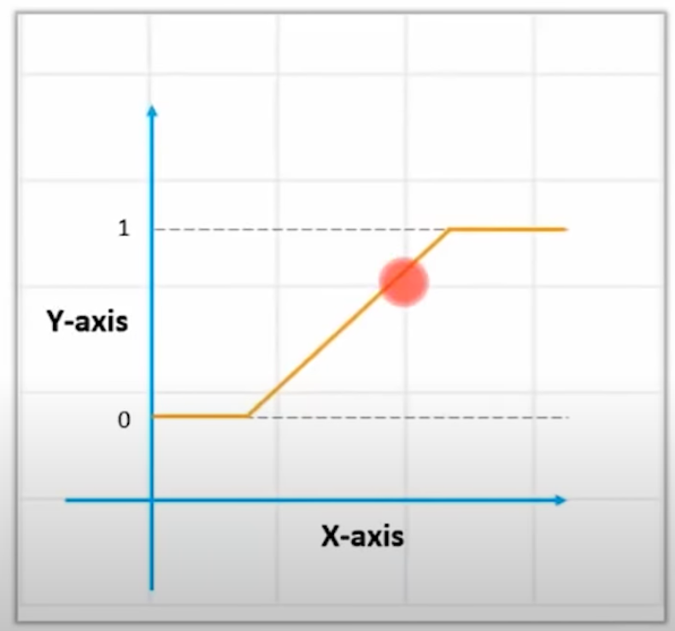
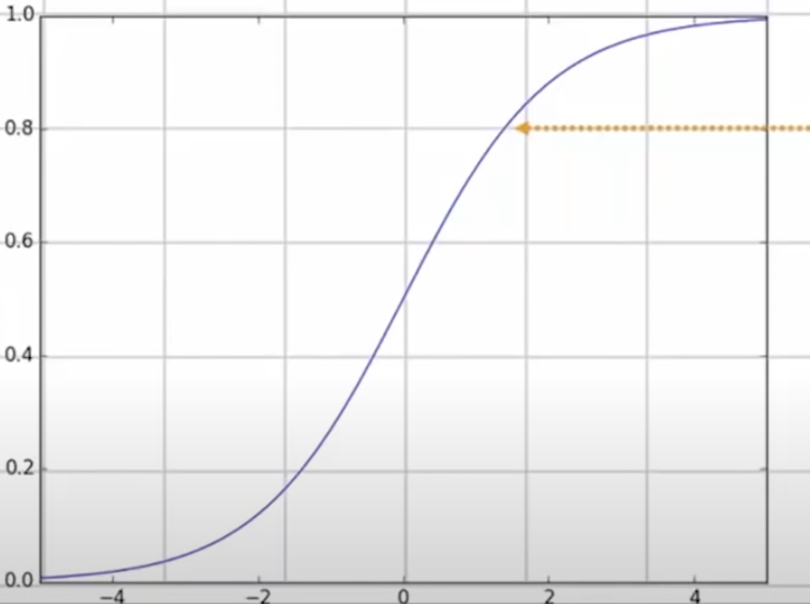
Class-2: Supervised Learning Algorithms – non-linear (logistic)
Can not be expressed with a linear
Looking into Sigmoid function
Threshold value

Slide 35
Class-2: Logistic Regression Equation
The Logistic Regression Equation is derived from the Straight Line Equation
Equation of a straight line
Y = C + B1X1 + B2X2 + …
Range from –(infinity) to +(infinity)
Let’s try to reduce the Logistic Regression Equation from Straight Line Equation
Y = C + B1X1 + B2X2 + …
In Logistic Equation Range from 0 to 1
To get the range of Y between 0 and infinity, we define
Y / (1-Y)
Where, Y=0 then 0
Y=1 then infinity
Range from 0 to infinity
Transform it further, and get range between –(infinity) and +(infinity)
Log(Y/(1-Y) => Y= C+ B1X1 + B2X2 + …
Logistic Regression Equation

Slide 36
Class-2: Linear Regression
Basic | Linear Regression | Logistic Regression
Core Concept | The data is modelled using a straight line | The probability of some obtained event is represented as a linear function of a combination of predictor variables
Used with | Continuous Variable (y = mx + c) | Categorical Variable (sigmoid function)
Output/Perdition | Value of the variable | Probability of occurrence of event
Accuracy and Goodness of fit | Measure by loss, R squared, Adjusted R squared etc | Accuracy, Precision, Recall, F1 scoure, ROC curve, Confusion Matrix, etc

Slide 37
Class-2: Logistic Regression Use Cases
Weather forecast (yes or no) vs Linear Regression (what temperatures)
Classification problem
Vertebrates (a bird, or a cat)
Determines Illness (based on the bio-data)
Practices:
Explore titanic dataset and explore about the people, both those who survived and those who did not. With today’s technology, answering questions through data analysis is now easier than ever:
what factors made people more likely survive the sinking of the Titanic?
Notes:
https://www.kaggle.com/mattslone/titanic-dataset-logistic-regression

Slide 38
Class-3: Supervised Learning Algorithms – Random Forest
Explain
Practice
Notes:
https://www.kaggle.com/zlatankr/titanic-random-forest-82-78
https://www.youtube.com/watch?v=eM4uJ6XGnSM

Slide 39
Class-3: Supervised Learning Algorithms
Random Forest
Random Forest Use-Cases
Random Forest Algorithm
KNN Algorithm
KNN Algorithm Working
KNN Demo
Naive Bayes
Naive Bayes Working
Industrial Use of Naive Bayes
Types of Naive Bayes
Steps involved in Naive Bayes
PIMA Diabetic Test Use Case
Support Vector Machine
Non-Linear SVM
SVM Use-case

Slide 40
Class-3: Supervised Learning Algorithms – Supported Vector Machine
Who is Vladimir Vapnik
Explain
Practice
Notes:
https://colab.research.google.com/github/jakevdp/PythonDataScienceHandbook/blob/master/notebooks/05.07-Support-Vector-Machines.ipynb

Slide 41
Class-3: Unsupervised Learning Algorithms
K-Means Clustering & Association Rule Mining
Types of Clustering
K-Means Clustering
K-Means Working
Pros & Cons of K-Means Clustering
K-Means Demo
Hierarchical Clustering
Association Rule Mining
Apriori Algorithm
Apriori Algorithm Demo

Slide 42
Class-3: Reinforcement Learning Algorithms
Reinforcement Learning
Reinforcement Learning: Counter-Strike Example
Markov's Decision Process
Q-Learning
The Bellman Equation
Transitioning to Q-Learning
Implementing Q-Learning

Slide 43
Class-3: Neural Network Intro

Slide 44
Content
Machine Learning Projects

Slide 45
Chess Play : Deep Blue
Analysis -> Strategy -> Tactics => MOVE
IF-Then rules
Look ahead & evaluate
Static values = g(f1, f2,…,fn)
Where g is linear scorning polynomial
Using British Museum Algorithm
Look Ahead as far as Possible

Slide 46

Constraints: Interpreting Line Drawings
Guzman->Huffman->Waltz
The whole world can be presented in these 2 things:
Assumptions:
General Positon
Trihedral + 3 Faces
3. Convex/Concave/Boundary
Terminologies:
Vertexes Junctions
Edges Lines

Slide 47
Constraints: Coloring USA Maps
Available color (domain): 4
States next to each other: different color
OK
B
G
AK
R
RGBY
TX

Slide 48
Content
ML Engineer Job Trends
ML Engineer Salary Trends
ML Engineer Skills
ML Engineer Job Description
ML Engineer Resume
Machine Learning Interview Questions

